Slide 1
#BPCSeminar

Slide 2
An interim analysis of the polls in 2019

Slide 3
Learning from Past Mistakes? An Interim Analysis of the Polls in 2019
John Curtice
British Polling Council

Slide 4
Performance of Final Polls in 2015
Based on 10 polls whose fieldwork did not end before 5.5.15; Polls by Opinium; YouGov; Survation; ComRes; Populus; Ashcroft, Ipsos MORI: BMG Research, Panelbase; ICM Research

Slide 5
All In The Same Boat

Slide 6
Performance of Final Polls in 2017
Based on all polls conducted by BPC companies whose fieldwork did not end before 6.6.17

Slide 7
Not (Quite) All As Bad As Each Other
A separate week-long mega-poll (55,000 respondents) by YouGov had estimates of Con 42, Lab 38

Slide 8
Performance of Final Polls in 2019
Source: Average of polls by BMG, Deltapoll, ICM, Ipsos, Kantar, Opinium, Panelbase, Savanta ComRes, Survation, YouGov. All were polls completed no earlier than 9.12.22

Slide 9
Many Were Relatively Close

Slide 10
2015: The Unweighted Figures
Unweighted based on average of nine final polls (Panelbase excluded). For some polls figures are estimates

Slide 11
2015: Actual Age Gap in Turnout

Slide 12
2015: Anticipated Age Gap in Turnout
* 18-24 vs 60+

Slide 13
Changes in 2017
Various attempts to improve the representativeness of samples, especially in recruiting those less interested in politics
Various schemes to weight the data more heavily for expected turnout differences, often relying on evidence from 2015

Slide 14
The Unweighted Figures in 2017
Based on nine final polls. In one instance (BMG) figures are demographically weighted

Slide 15
How Many Young Voters?
Panelbase estimated 19% of voters aged 18-34; Opinium 26%; BSA 2017: 23%

Slide 16
Too Many Conservatives (after weighting)?

Slide 17
Principal Changes in 2019
Very little weighting or modelling data to imitate demographic variation in turnout at the last election
Wider use of either requiring voters to choose from among the candidates standing in their constituency or of reallocating voters whose first preference party is not standing locally to their second preference.

Slide 18
Unweighted and Reported Data in 2019
Source: Average of 8 final polls by BMG, Deltapoll, ICM, Ipsos, Panelbase, Savanta ComRes, Survation, YouGov. Some figures based in part on an estimate. If we exclude Survation, which had a Scots booster, the unweighted Ns were Con 40, Lab 35, LD 12.

Slide 19
How Many Younger Voters in 2019?
Note in case of YouGov figure is for % aged 18-35.

Slide 20
Implied Age Differences in Turnout
In some instances, estimates are inferred from difference between the N for the whole sample and that for those with a vote preference

Slide 21
Weighted Con Share of 2017 Con + Lab vote)

Slide 22
Conclusions
Polls were more successful – but not infallible in 2019
Overall, there was a reversion to the typical historical slight tendency to overestimate Labour relative to Con
In contrast to 2017, weighting and filtering of the data (and dealing with Brexit party candidatures) typically improved poll estimates of Con lead
In 2017 weighting for turnout often resulted in too few younger people being included in estimates of vote intention – but in its absence in 2019 there was a tendency to have too many
In addition, the resulting apparent propensity in 2017 to have weighted samples that had too many 2015 Conservative voters was largely eliminated
But the key lessons of 2015 – the value of good sampling and good estimates of age differences in turnout remain valid.

Slide 23
Developments in MRP

Slide 24
Regression Methods
November 2022
Martin Baxter FOUNDER & CEO

Slide 25
Regression Overview
Regression Analysis provides a way to solve the problem of representative sampling
Similar concept to quota weighting, but more advanced
Can help partially with turnout modelling, but it is not a magic bullet
Gives results at seat level, or lower-level geographies

Slide 26
Sample size
Sometimes run with very large sample sizes, eg 100,000 respondents
Original US academic research got good results with small samples, eg 1,000 respondents
Our extensive backtesting shows that a sample of 5,000 usually works well.
Case study: two MRP polls on 10 Dec 2019
Electoral Calculus poll with 6,000 voters
Other poll with 105,000 voters
Only one seat difference in prediction

Slide 27
Recent technical improvements
Use of semi-analytic integration techniques to generate the posterior Bayesian distribution
Outperforms traditional Monte Carlo techniques for speed
Avoids problems with convergence
Include variates based on the political and demographic characteristics of the respondent’s local neighbourhood
Local historic Lib Dem strength often translates into Lib Dem voting next time
Local data about financial characteristics can be more revealing than respondents’ admissions

Slide 28
Results for GE 2019 – Final polls
Regression compared with classic swing-based model (UNS), using final campaign polls
Regression is a little more accurate than classic.
Our regression was the most accurate pre-poll prediction.
Party | Poll Vote Share | Classic | Regress-ion | GE result
CON | 43.3% | 344 | 351 | 365
LAB | 33.9% | 225 | 224 | 203
LIB | 11.7% | 17 | 13 | 11
Brexit | 3.2% | 0 | 0 | 0
Green | 2.7% | 1 | 1 | 1
SNP | 3.6% | 42 | 41 | 48

Slide 29
Thank you.
Electoral Calculus Ltd is a quantitative consultancy specialising in political and social research
For more details contact Martin Baxter on:
T: 020 3627 8141
E: martinbaxter@electoralcalculus.co.uk

Slide 30
The YouGov approach to MRP
How we assess public opinion and mid-term vote intention, and where do we go from here?
Dr Patrick English, Associate Director of European Political and Social Research

Slide 31
Agenda
YouGov and MRP
1. What is MRP?
2. How does YouGov use MRP?
3. Samples and assumptions
4. Future improvements
5. Future uses (research avenues)

Slide 32
What is MRP?
YouGov and MRP
Multilevel regression and post stratification: fit a multilevel model (… or just multiple) and use the fit to predict over a post-stratification frame of your population(s).
Most commonly used in polling to estimate vote intention at the constituency level.
Increasingly used to measure other things: best prime minister, most important issue, gambling behaviours.
Two main sources of ‘user error’ can be:
The model equation
Turnout assumptions
Two main sources of ‘data error’ can be:
Sample quality (and size)
Data sources for post-stratification frame

Slide 33
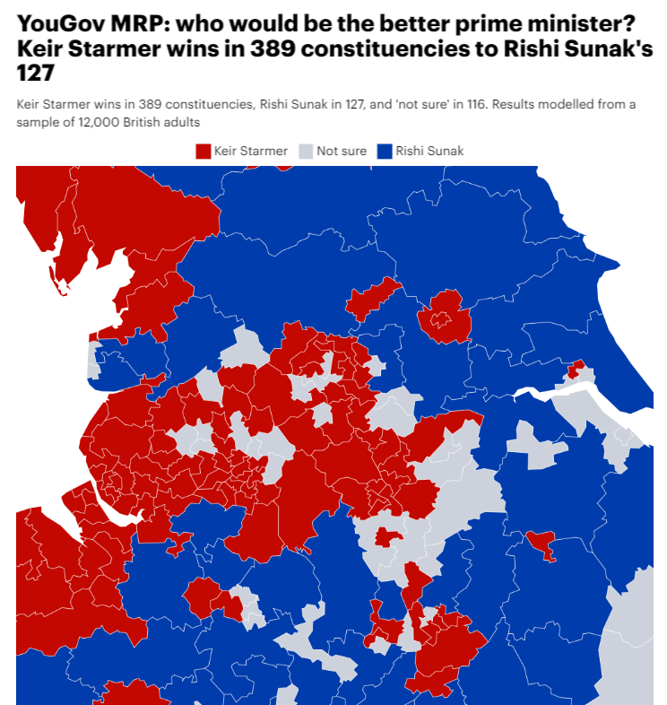
How does YouGov use MRP?
YouGov and MRP
YouGov has used MRP since 2017 for its election forecasting.
That 2017 model, predicting Theresa May would lose her majority, is arguably the most ‘famous’ MRP model.
We’ve recently increasingly used it in ‘mid-term’ scenarios, but not just for vote intention – and not just for PR purposes.

Slide 34
Samples and assumptions
YouGov and MRP
YouGov political MRP samples come from one of two sources.
For vote intention models, repeated waves of our nationally and politically representative daily polling samples:
Stitches together a ‘master file’ of around 12,000 valid vote intentions from combining waves and sifting out repeats.
Excludes “don’t know” and “would not vote” – mid-term vote intention.
Takes a couple of weeks, but extremely high quality sample.
For other models (i.e., best prime minister), survey trailing technology to collect big datasets quickly:
Appends a couple of questions to end of all surveys going out in GB.
Takes a handful of days to collect samples of around 100,000 people.
Is not quota’ed on any political measurement, but will be generally nationally representative.

Slide 35
Samples and assumptions
YouGov and MRP
YouGov’s position is that we need at least around 20 people per interpolated geographical area to properly take advantage of MRP’s strengths…
$\operatorname{Pr}\left(y_{a}\right)=\left[X_{ij}\right]+\left[X_{j}\right]+U_{j}+ ∈_{ij}$
$$σ^{2}=f(n)$$
n
1
$\left[X_{ij}\right]+\left[X_{j}\right] + ∈_{ij}$
$$\operatorname{Pr}\left(y_{a}\right)=$$
$$+U_{j}$$
These inflations can be ‘modelled out’ in terms of post-hoc accuracy, but for forecasting they present a unique challenge…

Slide 36
Samples and assumptions
YouGov and MRP
There are of course many assumptions to our vote intention model.
Assumption 1 – The equation
Equation for the multilevel part is [commercially redacted].
Developed by me to accurately predict both 2017 and 2019.
Assumes we have good measurements of each of [commercially redacted] in both our samples and post-stratification frame.
PS currently uses the APS… which is itself in part a survey measurement!
Assumption 2 – Turnout
A proper estimation of turnout stops you from being ~100 seats out with Labour/Conservative forecasts.
Our is a probability model from combining with 2015 and 2017 BES, with validated turnout as dependent variable.
Then fitted over the PS frame (assumed flat across constituencies, but nested within regions).

Slide 37
Future improvements
YouGov and MRP
A bunch of things I’d like to look into ahead of the next General Election:
Can we use the rapid trailing survey technology combined with a random post-stratification sampling script to get quick samples which are also balanced on political measures?
Updating the turnout model to use 2019 validated vote data - should we remove 2015, or just fit an intercept for election year?
Replacing annual population survey with Census 2021… when it comes out in its true and pure form!
Allowing ‘will not vote’ as a valid intention – can we get good turnout measurements, and (more importantly) capture turnout differentials?

Slide 38
Future uses (research avenues)
YouGov and MRP
MRP has a lot of potential uses which I think we are currently under-exploring:
Can we find an equation which makes sense for ranked preferences (e.g., what are the three most important issues in each constituency)?
Where is the synthesis between MRP and simulation in terms of producing and benchmarking point-estimates? Simulating MRPs…
Can we use MRP to find different types of sample bias (e.g. could we detect mis-reporting or mis-measurement in things like vaccination rates)?
On turnout – can we synthesise predicted turnout probabilities with self-reported probability to make an effective measurement?

Slide 39
New Strategies

Slide 40
Opinium voting intention methodology
BPC Methods seminar
November 2022

Slide 41
Why are we doing this?
Polling methodology is a constant process, we reviewed and revised before 2019 and 2016, sitting on the same “perfect” methodology is when you go wrong. It’s right to keep challenging and keep refining
2019 general election
2016 EU referendum
Opinium final poll
Opinium final poll
Opinium final poll
Opinium final poll
UK vote share
UK vote share
GB vote share
GB vote share

Slide 42
Two sets of changes in February 2022
Overdue housekeeping
Sampling and weighting by political attention
Based on BES 2015/17 face to face targets
Improved sampling and weighting by ethnicity
White, mixed race, Indian, Pakistani and Bangladeshi, Black, other ethnicities
Interlocking age, gender and education level
Avoiding samples having too many older graduates
Turnout weighting
TRADITIONAL METHOD:
Apply weighting to whole sample to demographics and past vote
Remove “don’t know” and “would not vote” responses to get final headline voting intention
NEW METHOD:
Remove “don’t know” and “would not vote” responses to give us the “voting population”
Apply weighting to this population to make it match the breakdown of the voting population in past elections
Notes:
OVERDUE HOUSEKEEPING
Political attention weighting is long overdue and is something we’ve wanted to bring in since at least 2015
For ethnicity we’re treating each major group separately rather than lumping everything into “BAME” and “not BAME”
Finally we’ve made a new variable in our standard weights that is age x gender x education level. In the last few elections having too many 65+ year olds with degrees hasn’t mattered too much because they all voted Conservative regardless. But in this parliament we’ve seen Labour do better among older age groups generally and that’s more apparent among those with more qualifications.
TURNOUT WEIGHTING
All this though is stuff we should always have been doing so the more contentious change has been our change to turnout weighting.
The traditional approach to this, certainly what we’ve done in the past, is a straightforward two step process: First you take your whole sample and apply your weighting scheme to it which probably includes a combination of demographics and political variables like past vote in recent elections. Then your “headline voting intention” question is just your question in the survey but filtering out people who said “don’t know” or “would not vote which usually cuts your sample down from 2,000 to about 1,300 so 65% which is about right given recent turnout.
Our method flips this around. We start with step 2 by removing “don’t know” and “would not vote” to give us our “voting population”. We then apply a new weighting scheme to the voter population to make them match the characteristics of what the BES tells us the electorate normally looks like.

Slide 43
What goes into the “voters weight”
Targets are based on an average of the 2015 and 2017 BES, 2019 will be added to this once it is verified:
‘16
‘19
Age x
Gender x
Education
Working status
Political attention
2016 EURef past vote
2019 GE past vote
Region
Ethnicity
Adding past vote into this is the ‘new’ bit and why our method differs from others.
Notes:
The factors going into the voters’ weight are mainly the same ones going into our population weight that we’d be using anyway, age/gender/education, region, working status (which doesn’t have that much effect but is a useful control), ethnicity, political attention and past vote. This is the controversial bit and where we differ from when this type of thing has been done elsewhere is that we include past vote in the targets.

Slide 44
If some of a party’s 2019 voters move to “don’t know”, those that remain are weighted up
2019 vote in the total sample

Slide 45
If some of a party’s 2019 voters move to “don’t know”, those that remain are weighted up
% “don’t know” or “would not vote”
2019 Conservative voters who tick “don’t know” or “would not vote”
2019 Labour voters who tick “don’t know” or “would not vote”

Slide 46
If some of a party’s 2019 voters move to “don’t know”, those that remain are weighted up
“Voters sample”

Slide 47
If some of a party’s 2019 voters move to “don’t know”, those that remain are weighted up
Final weighted ‘voters sample’
Those who would still vote whichever party they would vote for are upweighted to replace those that wouldn’t

Slide 48
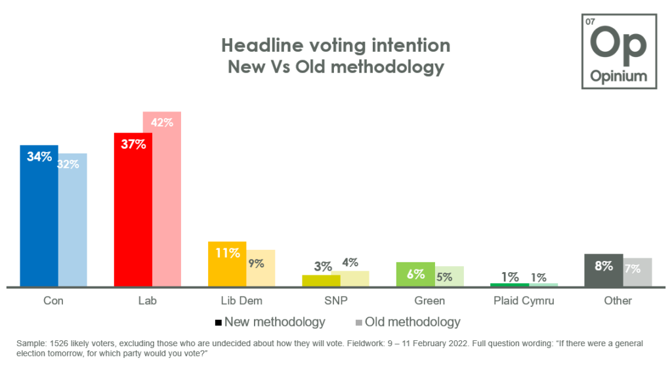
What is the effect of this?
Upweights groups that have disproportionately switched to “don’t know” or “would not vote” (e.g. 2019 Conservative voters)
Therefore smaller Labour leads when these are mostly caused by 2019 Cons going to “Don’t know”
Notes:
What this means is that when a significant proportion of a party’s supporters (say, an unpopular incumbent government) move to “don’t know”, our method upweights those that remain in the voters’ population. We don’t re-allocate “don’t know” respondents but the effect, on the face of it, is sometimes similar to the kind of ‘spiral of silence’ adjustment where other polls would throw “don’t knows” back into the mix at half weight for the party they used to vote for.
This therefore means we ended up with smaller Labour leads than most other companies and the first time we ran this, in Feb, you can see the difference the method change made, taking us from a 10 point lead down to a 3 point lead.

Slide 49
We’re much more influenced by switching between parties than between a party and “don’t know”
Notes:
Instead of being moved by the fluctuations in “don’t know” responses, our numbers are much more influenced by direct movement between parties. In effect, if you’re a 2019 Conservative voter who’s disillusioned with the party and moved to “don’t know” then you don’t affect us much but if you move to Labour then we start to see some big changes.
The chart is the result from four of our polls compared to the average of the 10 released by other companies around the same time (thank you Wikipedia) and you can see the gap get slightly wider for everyone else particularly during the Tory summer leadership election where our lead remained stubbornly small. Then we joined everyone else when voters started actually choosing Labour during the Truss incident.

Slide 50
We’re much more influenced by switching between parties than between a party and “don’t know”
11% | 11% | 13% | 30%
Share of 2019 Conservative voters going to Labour
Notes:
To show this another way, pink is the lead among everyone else, blue is the lead with Opinium, you see the pink lead really get larger in September (really the end of August as this was in the first week of September) while the blue one stays relatively small, and then the two converge a bit more in October.
At the bottom are the numbers that show why, even though everyone else had the Tory lead expanding in August/September, the actual number of Tory voters moving to Labour had barely budged from the partygate period. It’s only when you get to October that that number goes up and therefore so does our Labour lead

Slide 51
Some final points
It’s still a poll, not a projection
We are still asking about, and trying to ‘predict’ an election “tomorrow”
Excluding “don’t knows” without readjustment is also a big assumption
We are not making any more of a logical leap about turnout than we would by simply continuing with our prior methodology
Potential changes
In the future we’re looking at potentially introducing an element of self-reported likelihood to vote
Notes:
So a few final points to note:
This is still a poll, not a projection. We think it offers a more realistic and accurate picture of what would happen “if there was an election tomorrow” but it’s still about “an election tomorrow” rather than in 2024.
We’re not taking any wild swings here. Although we’re making some assumptions about the voters’ population, we think these are pretty well grounded in reality (the ‘voters population’ numbers don’t really move from election to election and if they’re different in 2019 then we’ll reassess).
Something we may consider, and need to do some experiments on this, is incorporating an element of self-reported likelihood to vote. So, for example, taking a mean of likelihood to vote among 2019 Tory voters, a mean among 2019 Labour etc. and weighting each group accordingly when they go into the voters’ sample

Slide 52
political@Opinium.com

Slide 53
SOME LESSONS FROM OTHER COUNTRIES
Simon Atkinson
Chief Knowledge Officer, Ipsos

Slide 54
THE QUESTIONS ARE VERY SIMILAR…
What is the “right”….
Data collection approach
Sample design
Weighting scheme
Turnout model
?

Slide 55
“It’s all about the local country, culture, context”

Slide 56
NO GLOBALLY STANDARDISED METHODOLOGY
What is the “right”….
Data collection approach
Sample design
Weighting scheme
Turnout model
?

Slide 57
NO GLOBALLY STANDARDISED METHODOLOGY
What is the “right”….
Data collection approach
Sample design
Weighting scheme
Turnout model
?

Slide 58
NO GLOBALLY STANDARDISED METHODOLOGY
What is the “right”….
Data collection approach
Sample design
Weighting scheme
Turnout model
?
Example: How to cover all types of urban areas?

Slide 59
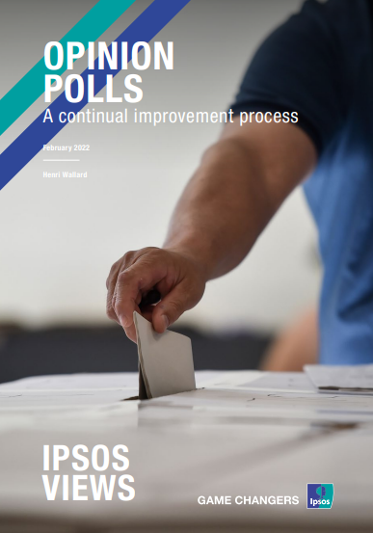
NO GLOBALLY STANDARDISED METHODOLOGY
What is the “right”….
Data collection approach
Sample design
Weighting scheme
Turnout model
…working across several countries is helping us refine & adapt approaches and explore new innovations
?
Download White Paper

Slide 60
There are some consistent challenges

Slide 61
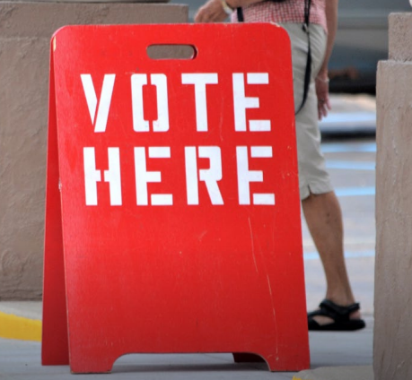
THERE ARE SOME CONSISTENT CHALLENGES
#1: Anticipating the turnout feels more important than ever - you can never take it for granted
2: Volatility is growing in many places, with a need to remain in field until the very last moment to capture the latest trend
#3: Capturing voters’ emotions, going beyond their demographics, is a challenge pollsters know they can’t neglect if they want to stay close to the dynamic

Slide 62
THERE ARE SOME CONSISTENT CHALLENGESY
#1: Anticipating the turnout feels more important than ever – you can never take it for granted
Each individual voter’s likeliness to vote at a given election varies over time and according to circumstances…

Slide 63
CHALLENGE #1: TURNOUT

Slide 64
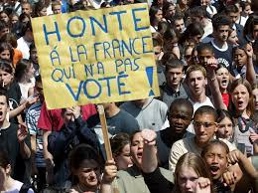
CHALLENGE #1: TURNOUT
Turnout on 1st round 71.60% down 7 pts. from 1995
Brings into focus: the concept of “regret”

Slide 65
MEASURING ANTICIPATED REGRET
France 2002
1. Many registered voters didn’t anticipate regret from not voting on the 1st round because they expected the two main contenders, Chirac and Jospin, to qualify…
2. They thought the real decision would not take place before the runoff, i.e. the long awaited showdown between the incumbent President and the incumbent Prime Minister…
3. But when the outcome of the first round was known to all voters, many of them expressed regret. And this significantly increased their likeliness to vote (and actual voting)
Turnout on runoff = 79.7%, equal to 1995
By measuring anticipated regret, we can fine tune the measurement of likeliness to vote (or vote hesitancy)

Slide 66
FRANCE 2022
Case Study
For the French 2022 election, Ipsos designed an Engagement Index, integrating civic duty and anticipated regret, together with additional indicators related to information, interest, satisfaction with the political “offering” and efficacy (“my vote counts”). This multi-dimensional approach produced good estimates of both turnout and voting shares.
Civic Duty
“To vote is a duty. People fought and died so that we all can vote.”
Anticipated Regret
“I would/wouldn’t feel regret if I didn’t vote and the election outcome weren’t the one I expect/prefer.”
Likelihood to vote
Interest
“Politics are important to me. Politics are of interest to me: I follow politics in the media.”
Satisfaction
“There is at least one candidate in this election who stands up for people like me/addresses the issues that matter to me.”
Efficacy
“My vote counts. My vote can make a difference.”

Slide 67
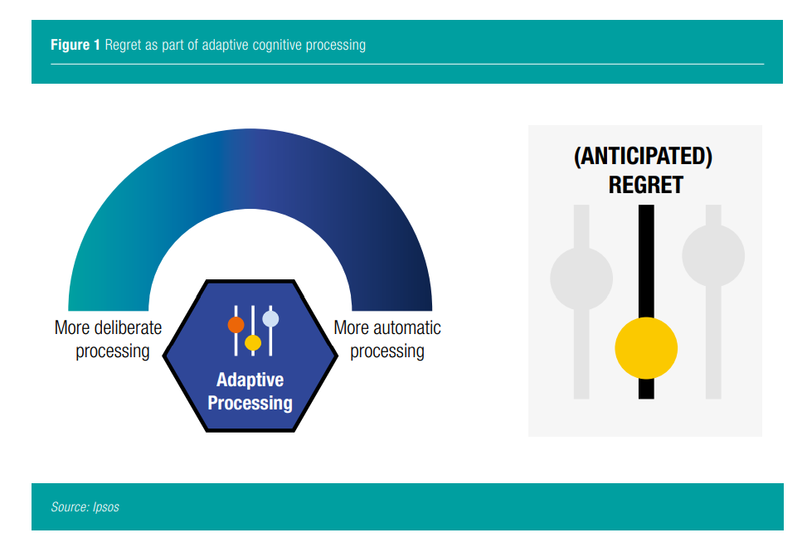
CORONAVIRUS VACCINE
Case Study
See this published case study on the measurement of vaccination hesitancy during the Covid pandemic
Download the white paper
People anticipating that they would regret not having get the vaccine if they were to get sick because of Covid were twice more likely to accept vaccination.

Slide 68
THERE ARE SOME CONSISTENT CHALLENGES
#1: Anticipating the turnout feels more important than ever - you can never take it for granted
2: Volatility is growing in many places, with a need to remain in field until the very last moment to capture the latest trend
#3: Capturing voters’ emotions, going beyond their demographics, is a challenge pollsters know they can’t neglect if they want to stay close to the dynamic

Slide 69
CHALLENGE #2: VOLATILITY
France 2021-22: big changes over time
…longitudinal surveys boost understanding of the dynamics

Slide 70
THERE ARE SOME CONSISTENT CHALLENGES
#1: Anticipating the turnout feels more important than ever - you can never take it for granted
2: Volatility is growing in many places, with a need to remain in field until the very last moment to capture the latest trend
#3: Capturing voters’ emotions, going beyond their demographics, is a challenge pollsters know they can’t neglect if they want to stay close to the dynamic

Slide 71
CHALLENGE #3: CAPTURING VOTERS’ EMOTIONS
Sometimes we need to go further than just asking a question.
People do not always acknowledge that their decisions are sometimes more based on gut feelings and mental shortcuts than on “quiet and mature thinking….”
Neuroscience and experimental psychology can help us here: scientists have demonstrated that response time and tracing people’s decision processes can give a more granular and more accurate idea of how certain people are of their decisions/choices. How can we apply this to voters?

Slide 72
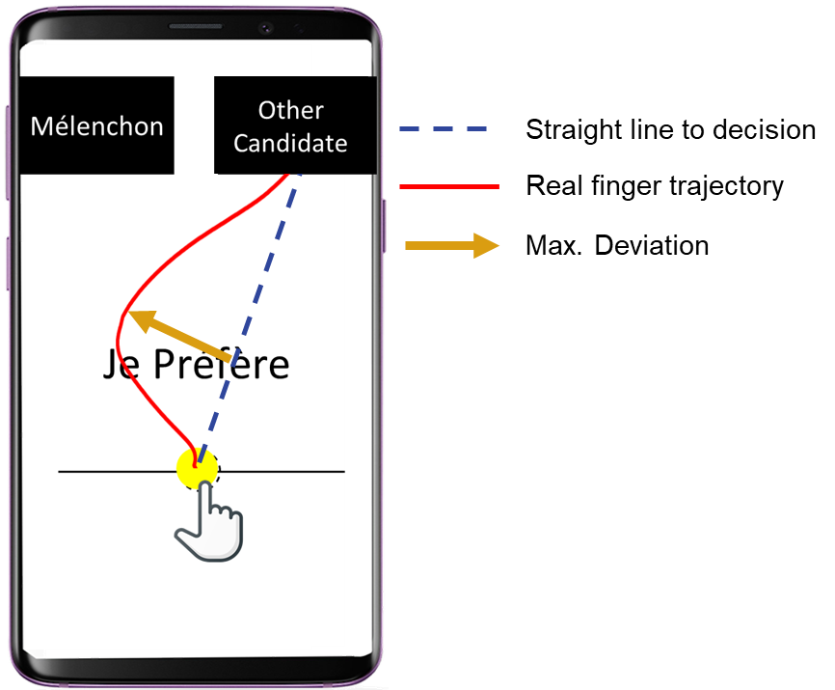
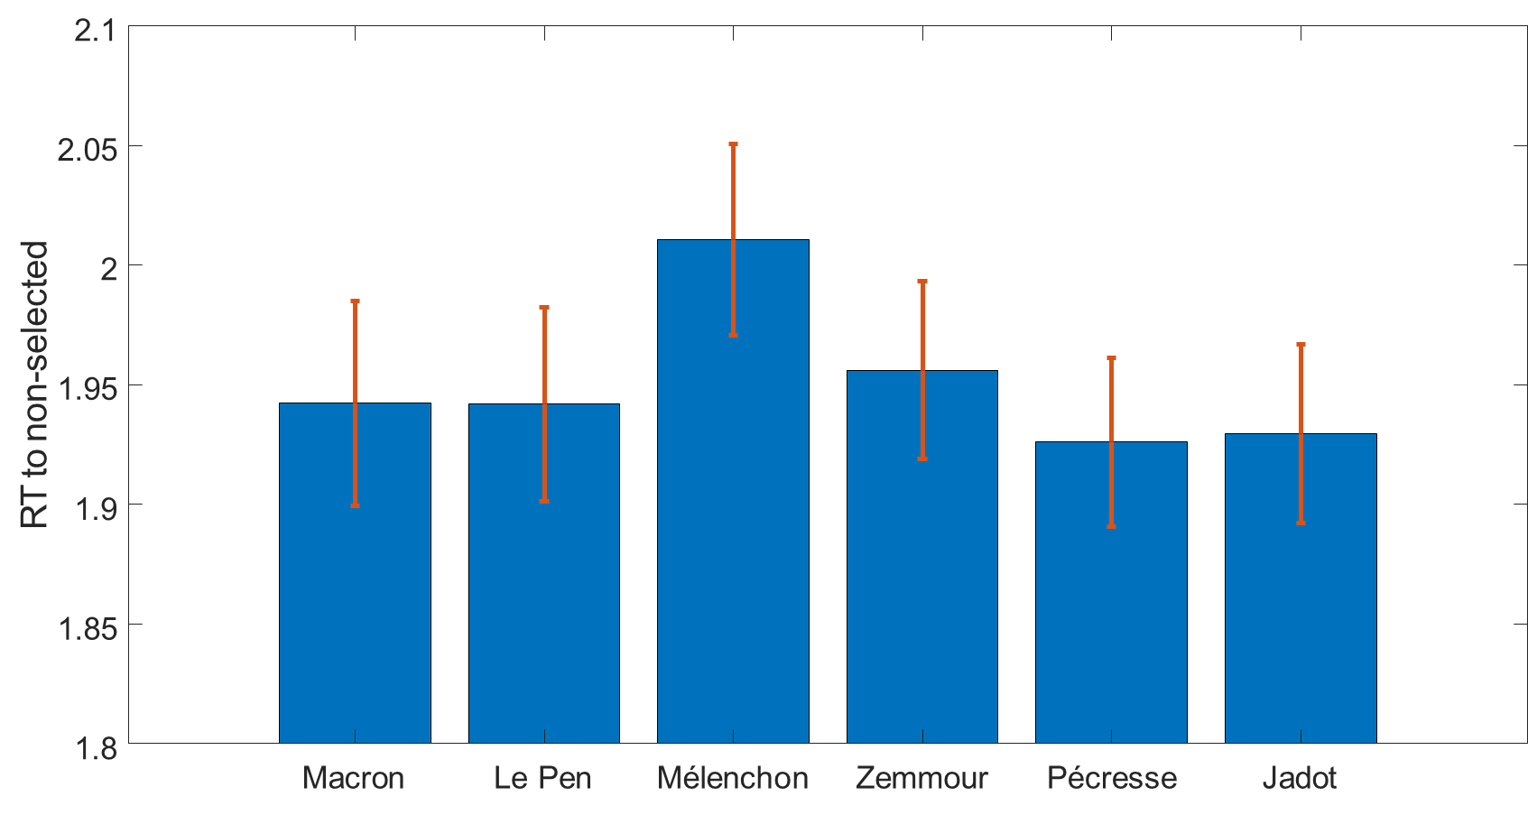
MEASURING RESPONSE TIME
Case Study: France 2022
Ipsos experimented with measuring response time and tracing voters’ decision process during the presidential campaign. It revealed that when a voter hesitates between two candidates, this hesitation can literally be traced on the screen of her smartphone, by following the path her finger took from a neutral, bottom position, to one of the two candidates in the upper corners of her smartphone screen!
Each respondent is proposed a choice between two candidates (randomly opposed) on each screen of the questionnaire.
Respondents are instructed to put their finger first on the neutral (yellow) point below candidates’ names and then to move their finger (continuously touching the screen) onto the candidate they prefer/select.

Slide 73
US CASE STUDY: BRINGING IN OTHER MARKET RESEARCH TECHNIQUES

Slide 74
BRINGING IN OTHER MARKET RESEARCH TECHNIQUES

Slide 75
BRINGING IN OTHER MARKET RESEARCH TECHNIQUES

Slide 76
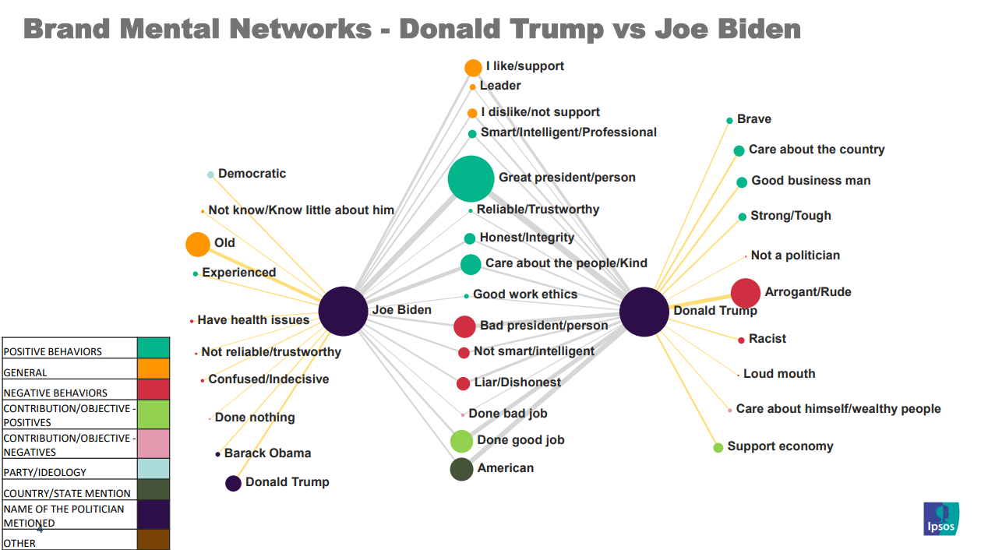
BRINGING IN OTHER MARKET RESEARCH TECHNIQUES

Slide 77
BRINGING IN OTHER MARKET RESEARCH TECHNIQUES
Download/watch the analysis here

Slide 78
SOME LESSONS FROM OTHER COUNTRIES
Simon Atkinson
Chief Knowledge Officer, Ipsos

Slide 79
SOME LESSONS FROM OTHER COUNTRIES: RESOURCES
Brand Biden v Brand Trump here
Evolution of Opinion Polls paper here
“Regrets” White Paper here

